Slide 1
TADAPANENI PAVAN SAI
Final Project

Slide 2
Keylogger & Security
A keylogger, short for "keystroke logger," is a type of surveillance technology used to monitor and record each keystroke made on a keyboard. Keyloggers can be implemented as either software or hardware. Software keyloggers are typically installed on a computer or mobile device, often covertly, and can capture a wide range of information, including passwords, messages, and other personal data. Hardware keyloggers, on the other hand, are physical devices that are connected to a computer, usually between the keyboard and the computer, to intercept and record keystrokes. While keyloggers can be used for legitimate purposes, such as monitoring employee activity or recovering lost data, they are more commonly associated with malicious activities, such as stealing sensitive information and perpetrating identity theft.

Slide 3
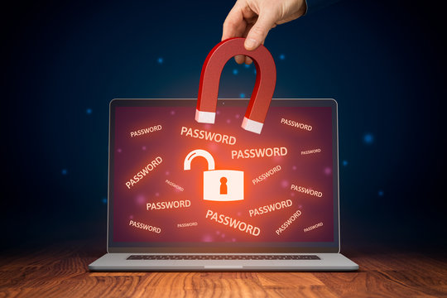
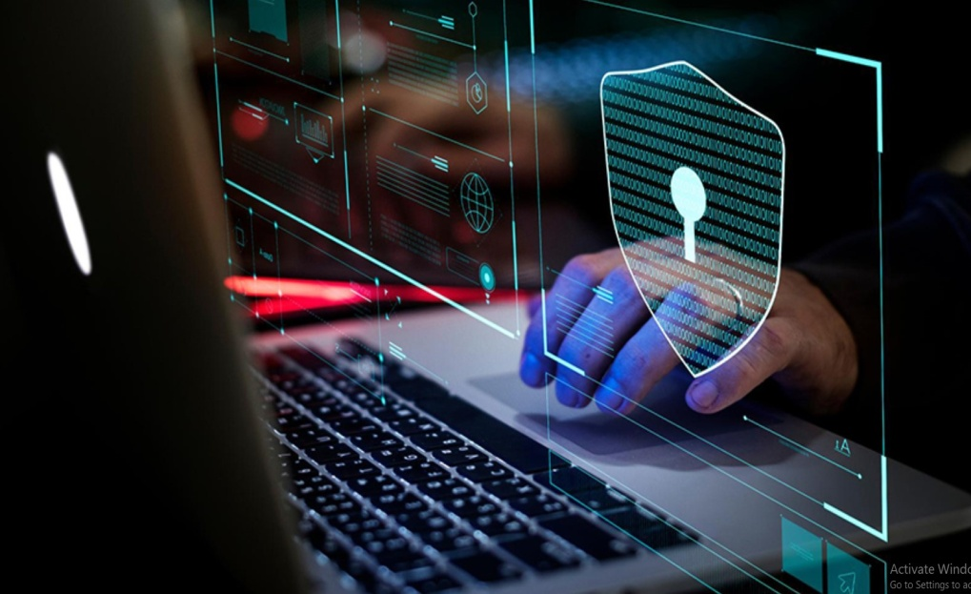
The importance of understanding keyloggers and enhancing security measures against them cannot be overstated, as these tools pose a significant threat to personal and organizational data security. Keyloggers, whether implemented through software or hardware, can covertly capture sensitive information such as passwords, financial details, and private communications, leading to severe consequences like identity theft, financial loss, and corporate espionage. Effective security practices, including the use of robust antivirus software, regular system monitoring, and adherence to safe browsing habits, are crucial in detecting and preventing keylogger infections.

Slide 4


AGENDA
Introduction to Keyloggers
Problem statement
Project overview
Who are the end users?
Solution and its value proposition
The wow in your solution
Detection of Keyloggers
Prevention and Protection Strategies
Modelling
Results
3/21/2024 Annual Review

Slide 5

PROBLEM STATEMENT
The increasing prevalence of keyloggers poses a significant threat to digital security, compromising the confidentiality and integrity of sensitive information. Despite advancements in cybersecurity, many individuals and organizations remain vulnerable to these covert tools, which can capture keystrokes to steal passwords, financial information, and confidential data.
This project aims to address the critical need for effective detection and prevention methods against keyloggers. It will explore the current landscape of keylogger technology, evaluate existing security measures, and develop innovative solutions to enhance protection against these threats. By doing so, the project seeks to mitigate the risks associated with keyloggers, safeguard personal and organizational data, and promote a secure digital environment.

Slide 6

PROJECT OVERVIEW
Keyloggers:
Keyloggers are software or hardware tools designed to capture and record keystrokes made on a keyboard.
They can be used for legitimate purposes such as monitoring employee activity or recovering lost data, but are often associated with malicious activities.
Software keyloggers are installed covertly on a computer or mobile device and can capture a wide range of information including passwords, messages, and other personal data.
Hardware keyloggers are physical devices connected to a computer that intercept and record keystrokes as they are typed.
Security Measures:
Security measures are protocols and tools implemented to protect against threats such as keyloggers and other forms of cyberattacks.
Antivirus and anti-malware software can detect and remove keyloggers and other malicious software from a system.
Regular system monitoring and audits help to identify any unauthorized access or suspicious activity.
Strong and unique passwords, along with multi-factor authentication, can prevent unauthorized access even if a keylogger captures login credentials.

Slide 7

Advantages of Keyloggers:
Monitoring and Surveillance: Keyloggers can be used for legitimate monitoring purposes, such as parental control to ensure children's online safety or employee monitoring to track productivity and adherence to company policies.
Data Recovery: In situations where data is accidentally lost, keyloggers can sometimes help recover the lost information by capturing keystrokes before they are deleted.
Investigative Tool: Law enforcement agencies and legal professionals can use keyloggers as part of their investigative toolkit to gather evidence in criminal cases or track suspicious activities.
System Diagnostics: Keyloggers can assist IT professionals in diagnosing technical issues and troubleshooting problems by providing a detailed log of user interactions.

Slide 8
Disadvantages of Keyloggers:
Privacy Invasion: Keyloggers have the potential to infringe on individuals' privacy by capturing sensitive information, such as passwords, personal messages, and browsing history, without their consent or knowledge.
Misuse and Abuse: Keyloggers can be misused for malicious purposes, such as stealing passwords, financial information, or intellectual property, leading to identity theft, financial fraud, or corporate espionage.
Legal and Ethical Concerns: The use of keyloggers without proper authorization or consent may violate privacy laws and ethical principles, resulting in legal repercussions and damage to reputation if discovered.
Security Vulnerabilities: Keyloggers themselves can become targets for exploitation by cybercriminals, leading to security vulnerabilities and potential breaches if not properly secured or maintained.
Cost and Complexity: Implementing comprehensive security measures can be costly and complex, requiring investment in software, hardware, personnel training, and ongoing maintenance.

Slide 9

WHO ARE THE END USERS?
Ethical Hackers and Security Professionals:
Ethical hackers and security professionals may use keyloggers as part of penetration testing or security assessments to identify vulnerabilities in systems and applications. This helps organizations improve their security posture by addressing potential weaknesses before they can be exploited by malicious actors.
IT Administrators:
IT administrators may utilize keyloggers to troubleshoot technical issues, diagnose problems, or monitor system usage within their organization's network.
Cybercriminals:
Unfortunately, cybercriminals may also be end users of keyloggers, employing them for malicious purposes such as stealing sensitive information like passwords, financial details, or personal data. This stolen information can be used for identity theft, financial fraud, or other illicit activities.

Slide 10

YOUR SOLUTION AND ITS VALUE PROPOSITION
Anti-Key-logger – As the name suggest these are the software which are anti / against key loggers and main task is to detect key-logger from a computer system.
Anti-Virus – Many anti-virus software also detect key loggers and delete them from the computer system. These are software anti-software so these can not get rid from the hardware key-loggers.
Automatic form filler – This technique can be used by the user to not fill forms on regular bases instead use automatic form filler which will give a shield against key-loggers as keys will not be pressed .
One-Time-Passwords – Using OTP’s as password may be safe as every time we login we have to use a new password.
Patterns or mouse-recognition – On android devices used pattern as a password of applications and on PC use mouse recognition, mouse program uses mouse gestures instead of stylus.
Voice to Text Converter – This software helps to prevent Keylogging which targets a specific part of our keyboard.

Slide 11
THE WOW IN YOUR SOLUTION
Revolutionary AI-Powered Detection: Our solution utilizes cutting-edge artificial intelligence (AI) algorithms to detect and prevent keylogger threats with unprecedented accuracy and efficiency. By continuously analyzing user behavior patterns and keystroke dynamics, our AI-driven system can identify even the most sophisticated keyloggers in real-time, providing proactive protection against evolving threats.
Predictive Behavioral Analysis and Auto-Remediation: Our solution harnesses the power of predictive behavioral analysis to anticipate and preemptively neutralize keylogger threats. By analyzing user behavior patterns and device interactions in real-time, our system can accurately predict when a keylogger is attempting to compromise the system.
11

Slide 12
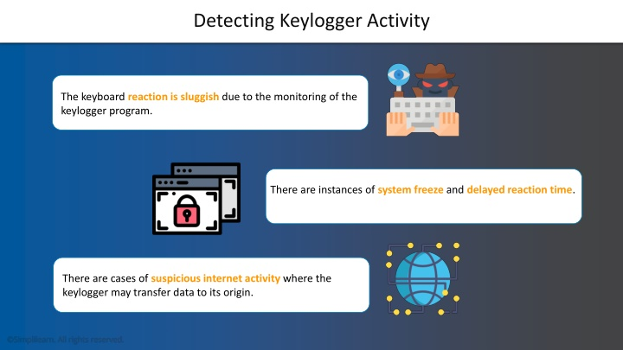
Detection of Keyloggers

Slide 13
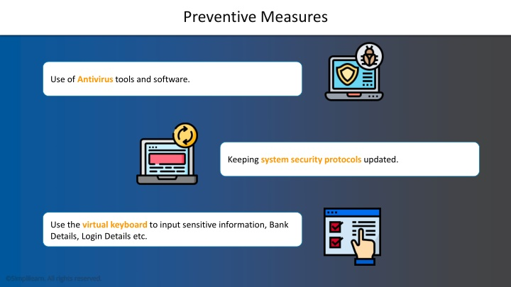

Slide 14
MODELLING
Import Required Modules:
Use Python's keyboard module to capture keystrokes.
Optionally, use other modules for logging, encryption, or network communication.
Set Up Logging:
Configure logging settings to specify the format and destination of log files.
Define Keylogger Function:
Create a function to capture and log keystrokes.
Use the keyboard.on_press() method to register a callback function to capture each key press event.
Main Function:
Create a main function to start the keylogger and keep it running indefinitely.
Testing and Deployment:
Test the keylogger program to ensure it captures keystrokes correctly.
Deploy the keylogger on target systems if necessary, ensuring compliance with legal and ethical considerations.
14

Slide 15
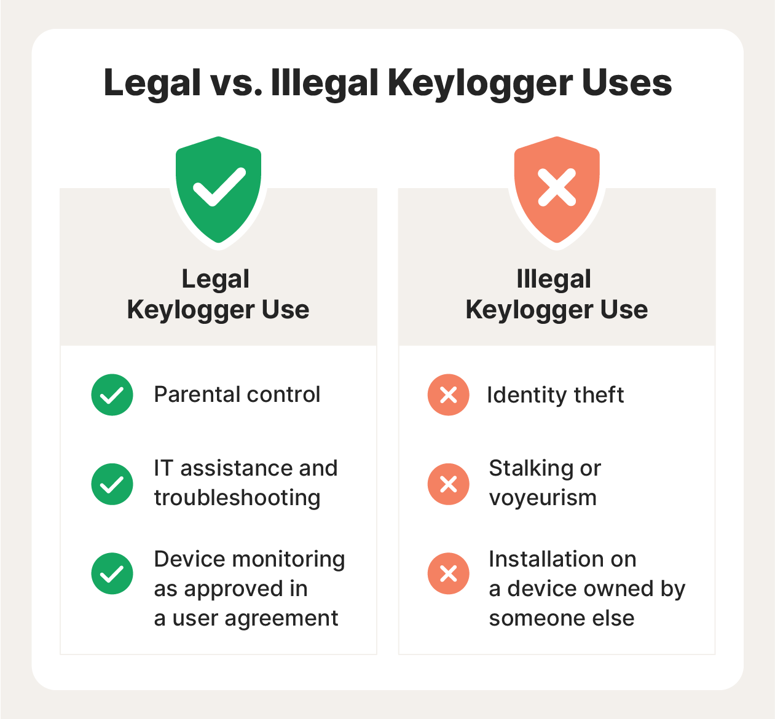
MODELLING
Innovative Approach: Combining technical measures with user education for comprehensive protection.
Demonstration: Real-time demonstration of a simple keylogger to illustrate the threat and the effectiveness of security measures.
Impact: Significant reduction in the likelihood of keylogging attacks through proactive measures.
15

Slide 16

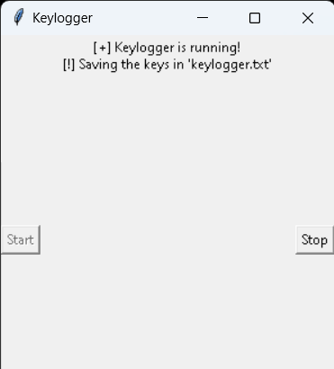
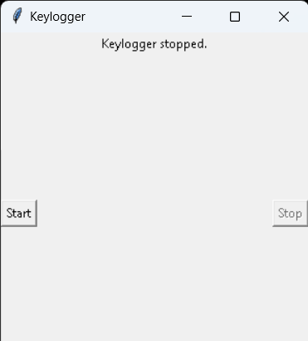
RESULTS
The result of a keylogger program typically involves capturing and logging keystrokes entered by a user on a keyboard. These logged keystrokes can then be used for various purposes, depending on the intent of the keylogger user. The covert nature of keyloggers allows them to capture sensitive information, including passwords, personal messages, and financial details, without the user's knowledge or consent. This poses serious risks to individuals, organizations, and society at large, including identity theft, financial fraud, and unauthorized access to confidential data.
16

